Slide 1
Computer Science AP
Test Taking Strategies

Slide 2
What happened last year
Nationwide score distribution from 2017 JPS Scores (2017)____
CSAP (32) Java (7) Other (15)
24.2 % received a 5 12 3 5
20.9% received a 4 12 2 4
21.9% received a 3 8 1 3
11.5% received a 2 0 0 3
21.5% received a 1 0 1 0
60,519 students took the exam in 2017
Check out: http://appass.com/calculators/computerscience

Slide 3
Know what is covered on the test
Go the College Board site
https://apstudent.collegeboard.org/apcourse/ap-computer-science-a (go to page 5and 6)
http://media.collegeboard.com/digitalServices/pdf/ap/ap-computer-science-a-course-description.pdf (go to page 66)
Review the list of topics that are covered.
Get familiar with the reference sheet ( pg. 67)

Slide 4
Know how the test is structured
Part I - 40 Multiple Choice questions in 1 ½ hours
Part II - 4 Free Response Questions in 1 ½ hours (2-3 parts per question)
The are equally weighted, equally important to do your best!

Slide 5
Perfect Practice Makes Perfect
Invest in a review book:
Barron's Computer Science AP Review
Each topic has a review section and a collection of M/C questions with answers and explanations. Also, includes a 2 practice exams in the book and CD with additional exams.
Practice, Practice, Practice

Slide 6
Java language details you need to remember
Integer division
4/5 → 0
5/4 → 1
5.0/4 → 1.25
length(), size() and length
String, ArrayList , arrays
String methods
substring (int b, int e)
charAt (int n)
Matching if with else - every else is matched with the closest if
Choose appropriate variable names. Use single letter variable names only as a loop control variable. Then make sure you spell your own variable name correctly.

Slide 7
Java language details you need to remember
Null, true and false do NOT have quotes around it
OBOE
make sure your loops are not Off By One
Demorgan’s law - saves time
!(a && b) → !a || !b
!(a || b) → !a && !b
Passing parameters to methods
formal parameters get copies of actual parameters
if the parameter is an object, contents of the object are subject to change by the method; the actual parameter is not changed
For-each loops
cannot be used to modify an array
there are no subscripts (can’t refer to element before or element after)

Slide 8
Java language details you need to remember
Visibility of instance or class variables/methods - big deduction on FRQ
other objects or psvm cannot access anything declared private (usually instance vars and helper methods)
other objects or psvm can call public static class variables and public static class methods
Constants cannot be modified. No assignment statements for constants
Arrays
subscript for first element is 0
swapping elements
array name is the reference or address
passing arrays to a method - the array may be modified by method
passing an element (primitive) to a method - the array remains unchanged after the method
passing an element (obj ref) to a method - the element (object) may be modified by the method

Slide 9
Java language details you need to remember
Class Definition
Initialize instance variables in the constructor, not in the declaration statement
DO NOT redeclare an instance variable in a method
An instance variable is used to describe the state of an object and is NOT a “global variable”
Comparing objects
== for primitive data and references
.equals() for contents of objects, returns boolean
.compareTo() for contents of objects, returns positive, negative or zero
Short Circuit Evaluation - suppose n = 0
if (n != 0 && 3/n > 2)
ArrayList
remove (int n) - removes element at index n AND shifts remaining elements to the left. WATCH for M/C questions that have a call to remove with a for loop. Consider traversing the arraylist backwards (subscript n-1 to subscript 0)

Slide 10
Multiple Choice Questions
Invest in a good eraser. Make sure you bubble in what you want and completely erase what you don’t want.
The questions with Roman numeral I, II and III take more time.
Beware of the distractor.
Do NOT leave anything blank. From the CollegeBoard site:
If you have to guess, make it an educated guess. Eliminate one or two choices and then guess. The more choices you can eliminate the better the chances of getting the correct answer.
Beginning with the May 2011 AP Exam administration, there was a change to the way AP Exams are now scored. Total scores on the multiple-choice section are now based on the number of questions answered correctly. Points are no longer deducted for incorrect answers and, as always, no points will be awarded for unanswered questions.

Slide 11
Multiple Choice Questions
Read ALL the choices before you commit to an answer. Sometimes it may help to read the choices before you read the question
Feel free to mark up the exam book as much as you want. Circle, underline important information.
If a question takes more than 2 minutes, consider skipping it for now and getting back to it later.

Slide 12
Free Response Questions
NO MORE S.O.P. - System.out.print()
Partial credit is very generous. Write something down but avoid using System.out.print() just because you have no idea what to write down
Attempt ALL 3 or 4 parts of each FRQ. They are graded independently.
The return type should match what is returned
Efficiency does not matter but strive for clear, concise code
Read the entire question before beginning
Re-read the pre-condition and post-condition
Cross off anything that you do not want graded. If there are two or more solutions to the FRQ, the Reader is instructed to grade the first one.

Slide 13
Free Response Questions
Write ONLY what is requested. No more, no less.
Indenting shows you wanted to block statements even if you forget { }
Don’t bother with comments. Readers are instructed to ignore them. It is a waste of time
Read the comments provided in the question. Sometimes the algorithm is imbedded in the comments. It may even say “you may use this algorithm”. HINT, HINT!
It is not necessary or recommended going outside the AP Subset
Write clearly and legibly. Not too big, not too small, just right. Be kind to the reader.

Slide 14
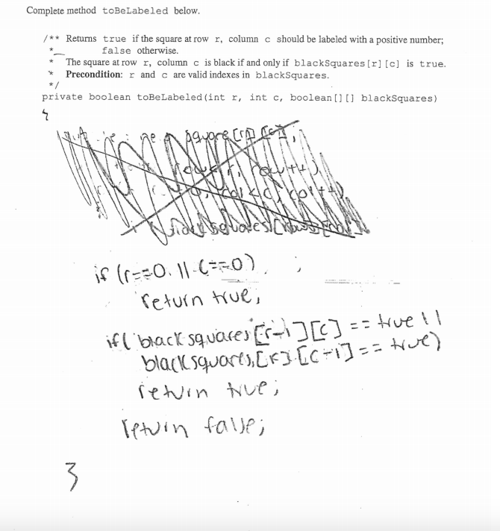
Cross out if you change your mind

Slide 15
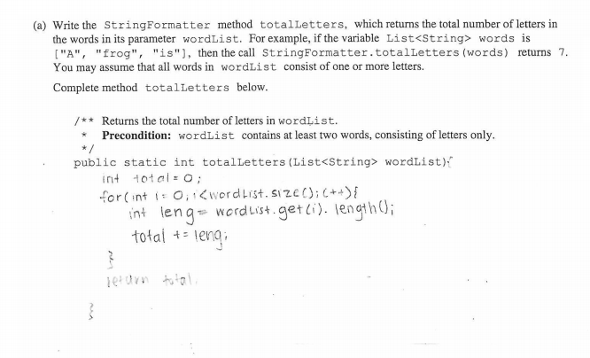
: )

Slide 16
Alternative/Additional Review
Get together with your peeps and create a study group
Find videos on Khan Academy and YouTube
Create your own flash cards or start using this set https://drive.google.com/file/d/0BywDXpG7Qx_WZ3RqR0wtZmYzc1k/edit

Slide 17


Preparing for Test Day
Do NOT pull an all-nighter the day before the test. Add an extra hour sleep if possible
Eat healthy, sensible breakfast the morning of the test. Not Frosted Flakes or Cocoa Puffs. http://www.goodluckexams.com/what-to-eat-before-an-exam/
Stay hydrated before and during the test
Do not wear your smart watch or any digital watch that may beep. Wear an analog watch to track your time during the test.
Do not wear your “Hello World” or any other geek t-shirt on test data.

Slide 18
GOOD LUCK
5
5
5
5
5
5
5
5

